Slide 1
CHAPTER ONE
ESSENCE OF PSYCHOLOGY

Slide 2
Cont.…
The word "psychology" is derived from two Greek words 'psyche' and ‘logos’.
Psyche refers to mind, soul or sprit
logos means study, knowledge or discourse.
Psychology epistemologically refers to the study of the mind, soul, or sprit
it is often represented by the Greek letter ᴪ (psi) which is read as ("sy").

Slide 3
Today, as a modern discipline, psychology is defined as:
The scientific study of behavior and mental processes.“

Slide 4
Behavior Includes all of a person’s overt actions and reactions, which can be observed by others such as eating, talking, smiling, and working.
Mental processes Refer to all the covert activities that other people cannot directly observe. Activities such as thinking, dreaming, feeling, and remembering are examples of mental processes.

Slide 5
Cont…
Scientific
- Uses systematic methods to observe, describe, explain and
control behavior.
- An empirical science that conduct scientific investigation
(e.g., observation and experimentation).

Slide 6
Cont…
Two purposes of studying animals behavior.
a. It is ethically forbidden to conduct some experiments on human beings, so animals are subject to experiment.
b. Conclusions obtained from experiments on animal behavior are usually applicable to human behavior.

Slide 7
Goals of Psychology
Description
- Naming and classifying. Making a detailed record of behavioral observations.
- Giving clear picture about the phenomena. Or tell about what something is like.
- To describe, a psychologist would ask ‘what is happening?’, ‘when it happens?’ and ‘to whom it happens?’
Explanation
- The second goal is to find out ‘why is it happening?’ In other words, the psychologist is looking for an explanation for the observed behavior or mental processes.
- Telling about why certain behavioral phenomenon is occurred.
Prediction
- The ability to forecast behavior accurately.
- Telling what something would be like in the future.
Control
- Manipulation or managing of a situation based on description, explanation, & prediction.
- It involves answering the questions “how”, “when” and “where” to intervene.
-This goal is to change an undesirable behavior to a desirable one.

Slide 8
To illustrate all the 4 goals, consider the following example.
A group of psychologists observe a number of students in order to describe how large their vocabulary typically is at a certain age. Then, they would attempt to explain how students expand the vocabulary and why some students have limited number of vocabulary. Psychologists would predict that students with limited number of vocabulary will probably continue to do poorly in academic. Finally, the psychologists would propose certain language learning strategies that can be used to increase the size of vocabulary of the students.

Slide 9
Major Sub fields of Psychology

Slide 10
Clinical psychology Clinical psychology deals with the study, diagnosis, and treatment of psychological disorders.
Clinical neuropsychology Clinical neuropsychology unites the areas of biopsychology and clinical psychology, focusing on the relationship between biological factors and psychological disorders.
Cognitive psychology Cognitive psychology focuses on the study of higher mental processes.
Counseling psychology Counseling psychology focuses primarily on educational, social, and career adjustment problems.

Slide 11
Cross-cultural psychology Cross-cultural psychology investigates the similarities and differences in psychological functioning in and across various cultures and ethnic groups.
Developmental psychology Developmental psychology examines how people grow and change from the moment of conception through death.
Educational psychology Educational psychology is concerned with teaching and learning processes, such as the relationship between motivation and school performance.
Environmental psychology Environmental psychology considers the relationship between people and their physical environment.

Slide 12
Evolutionary psychology Evolutionary psychology considers how behavior is influenced by our genetic inheritance from our ancestors.
Experimental psychology Experimental psychology studies the processes of sensing, perceiving, learning, and thinking about the world.
Forensic psychology Forensic psychology focuses on legal issues, such as determining the accuracy of witness memories.
Health psychology Health psychology explores the relationship between psychological factors and physical ailments or disease.
Industrial/organizational Psychology Industrial/organizational psychology is concerned with the psychology of the workplace.

Slide 13
Personality psychology Personality psychology focuses on the consistency in people’s behavior over time and the traits that differentiate one person from another.
Psychology of women Psychology of women focuses on issues such as discrimination against women and the causes of violence against women.

Slide 14
School psychology School psychology is devoted to counseling children in elementary and secondary schools who have academic or emotional problems.
Social psychology Social psychology is the study of how people’s thoughts, feelings, and actions are affected by others.
Sport psychology Sport psychology applies psychology to athletic activity and exercise.

Slide 15
Early Schools of Psychology
A school of thought is a system of thinking about a certain issue, say, for example, about human behavior or mind.
The schools of thought in modern psychology are:
Structuralism
Functionalism
Behaviorism
Gestalt Psychology, and
Psychoanalysis

Slide 16

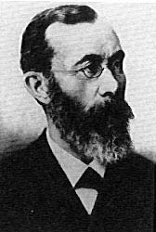


STRUCTURALISM:
STRUCTURALISM:
Wilhelm Wundt and Edward Titchener
Wilhelm Wundt and Edward Titchener
Wilhelm Wundt (1832-1920):
Wilhelm Wundt (1832-1920):
•Established first Psychology Lab in Germany.
•Defined psychology as the science of human mind and consciousness.
•Used the method of objective introspection to identify the basic mental elements.
Edward Titchener (1867-1927):
•Transferred Wundt’s ideas to America.
•Established first Psychology Laboratory of
Psychology at the university of Leipzig, Germany in 1879. Wundt believed that the proper object of study for the science of psychology was the content of the conscious mind.
•Defined psychology as the science of human mind and consciousness.
•Used the method of objective introspection to identify the basic mental elements.
Wilhelm Wundt (1832-1920)

Slide 17
STRUCTURALISM
To analyze mental elements, Wundt used an experimental method called introspection, whereby a subject reported as objectively as possible the contents of his own mind.
Wundt concluded that there were three basic mental elements: sensations, images, and feelings. Sensations are experiences of stimuli perceived through the senses; images are sensation-like experiences produced by the mind and, feelings are the emotional aspects of an experience.

Slide 18
STRUCTURALISM
Edward Titchener (1867-1927):
•Transferred Wundt’s ideas to America.

Slide 19

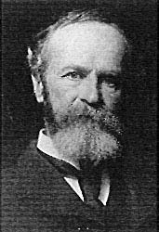


FUNCTIONALISM
FUNCTIONALISM
William James
William James
William James (1842-1910):
William James (1842-1910):
•Published “Principles of Psychology” in 1890. The book covers a wide range of topics, opening up the field of psychology.
•Opposed Wundt’s elemental approach, believed that “consciousness is a constant flow”.
•Believed that psychology should focus on the usefulness (or functions) of mental (learning and perceptual) abilities -- functionalism.
•Published “Principles of Psychology” in
1890. The book covers a wide range of
topics, opening up the field of psychology.
•Opposed Wundt’s elemental approach, believed that “consciousness is a constant flow”.
•Believed that psychology should focus on the usefulness (or functions) of mental (learning and perceptual) abilities -- functionalism.
William James (1842-1910)

Slide 20

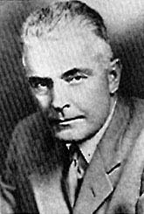


BEHAVIORISM:
BEHAVIORISM:
John B. Watson
John B. Watson
John B. Watson (1878-1958):
John B. Watson (1878-1958):
•Argued strongly against structuralism and contended that psychology should focus only on measurable and observable behavior -- behaviorism.
•Defined psychology as the science of behavior.
•The task of psychologists is to establish the laws of behavior: S (stimulus) ------ R (response).
•Believed in the dominant influence of learning and environment as opposed and heredity.
•Argued strongly against structuralism and
contended that psychology should focus only on measurable and observable behavior -- behaviorism.
•Defined psychology as the science of behavior.
•The task of psychologists is to establish the laws of behavior: S (stimulus) ------ R (response).
•Believed in the dominant influence of learning and environment as opposed and heredity.
John B. Watson (1878-1958)

Slide 21

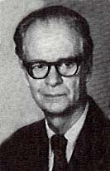
BEHAVIORISM:
BEHAVIORISM:
B. F. Skinner
B. F. Skinner
B. F. Skinner (1904-1990):
B. F. Skinner (1904-1990):
•A strong believer of behaviorism.
•Contributed enormously in the area of operant conditioning - learning by the consequences of behavior.
•Emphasized the roles of reinforcement and punishment in shaping and modifying behavior.
•A strong believer of behaviorism.
•Contributed enormously in the area of operant conditioning - learning by the consequences of behavior.
•Emphasized the roles of reinforcement and punishment in shaping and modifying behavior.
B. F. Skinner (1904-1990)

Slide 22

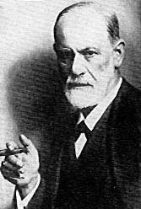
PSYCHOANALYSIS:
Sigmund Freud
PSYCHOANALYSIS:
Sigmund Freud
Sigmund Freud (1856-1939)
•Founder of Psychoanalysis - a personality theory and an approach to psychotherapy.
•Stressed the importance of unconscious motives.
•Emphasized the roles of early childhood experience (psychosexual stages).
Sigmund Freud (1856-1939)
Sigmund Freud (1856-1939)
•Founder of Psychoanalysis - a personality theory and an approach to psychotherapy.
•Stressed the importance of unconscious motives.
•Emphasized the roles of early childhood experience (psychosexual stages).

Slide 23
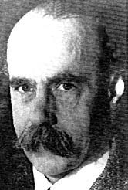
GESTALT PSYCHOLOGY:
GESTALT PSYCHOLOGY:
Max Wertheimer
Max Wertheimer
Max Wertheimer (1880-1943)
Max Wertheimer (1880-1943)
•Focused on perception and how perception influences thinking and problem solving.
•“Gestalt” means whole, configuration, pattern, and Gestalt psychologists illustrated how we tend to perceive separate pieces of information as integrated wholes.
•Opposed Wundt’s approach in searching for basic mental elements, because “the whole is more than the sum of its parts”.
•Focused on perception and how perception influences thinking and problem solving.
•“Gestalt” means whole, configuration, pattern, and Gestalt psychologists illustrated how we tend to perceive separate pieces of information as integrated wholes.
•Opposed Wundt’s approach in searching for basic mental elements, because “the whole is more than the sum of its parts”.
Max Wertheimer (1880-1943)

Slide 24
Major Perspectives of Psychology

Slide 25
Perspectives
Psychoanalytic
Behaviorism
Humanism
Cognitive
Evolutionary
Biological/Biomedical
Sociocultural

Slide 26
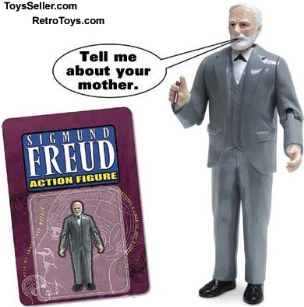
Psychodynamic
The psychodynamic perspective originated with the work of Sigmund Freud. This perspective emphasizes the role of the unconscious mind, early childhood experiences, and interpersonal relationships to explain human behavior and to treat people suffering from mental illnesses.

Slide 27
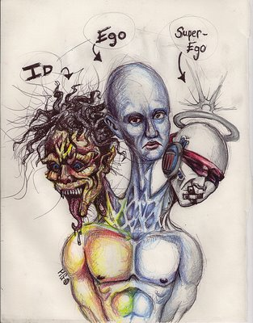
Cont…..
Our personality is a conflict between our unconscious Id and our superego (our moral sense) and our ego (our sense of reality).

Slide 28
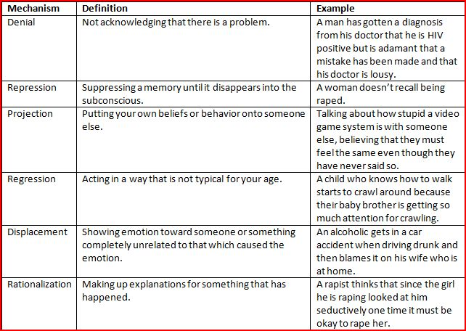
Defense Mechanisms

Slide 29
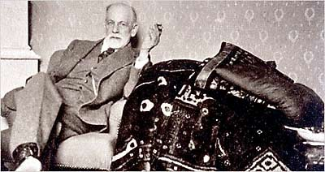
Psychoanalysis
Psychoanalysis is the form of treating psychological disorders, invented by Freud.
It is famous for the couch.

Slide 30
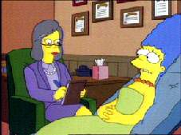
What are Psychoanalytic methods of therapy (4 of them):
A. Free Association – patient reports anything that comes to his/her mind.
The psychoanalyst listens for links & themes that might tie the patient’s fragmentary thoughts or remarks together.

Slide 31
B. Dream analysis:
Dreams have two types of content:
Manifest content- actual events in dream.
Latent content – hidden message in dream.
Freud thought that each dream represents a form of wish fulfillment. The wish may be disguised, but it is always there.

Slide 32
C. Transference
Feelings of love or other emotions (hatred) are expressed toward the therapist.
These feelings are actually unconsciously felt toward others; the patient is projecting these feelings onto the therapist.
This provides clues about the client’s feelings about these other people.

Slide 33
D. Hypnosis
Hypnosis is a psychoanalytic therapeutic technique.
Supposedly reaches into the unconscious

Slide 34
Pros of Freud’s theory
1. Argued that childhood experiences are important in personality development.
2. Information outside of awareness does influence us.
3. Defense mechanisms—good descriptions of some of our behaviors.

Slide 35
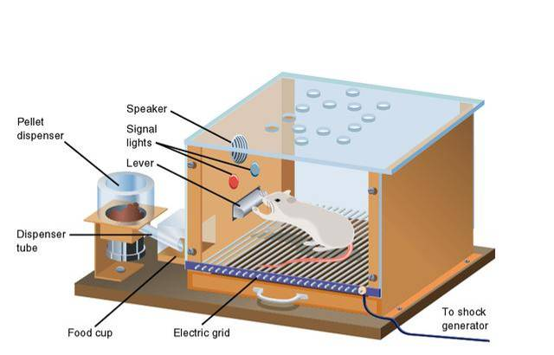
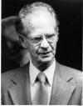
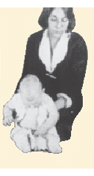
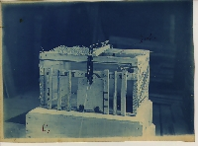
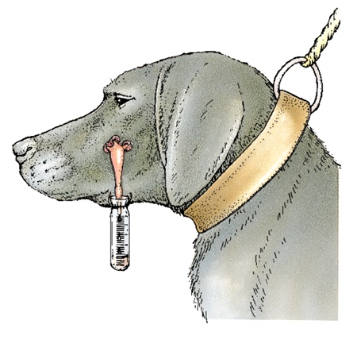
Behaviorism

Slide 36
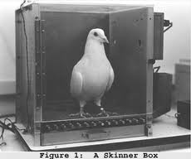
Behaviorism
By the 1950s, Psychoanalysis seemed very unscientific. Behaviorists will bring science back into psychology, even if they overdo it a little.
Behaviorism is NOT interested in the unconscious mind since it cannot be observed in a laboratory.

Slide 37
Very telling quote!!
Give me a dozen healthy infants, well-formed, and my own specified world to bring them up in and I’ll guarantee to take any one at random and train him to become any type of specialist I might select -- doctor, lawyer, artist, merchant-chief and, yes, even beggar-man and thief, regardless of his talents, penchants, tendencies, abilities, vocations, and race of his ancestors. --John Watson, Behaviorism, 1930

Slide 38
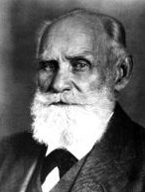
Ivan Pavlov
He was not a psychologist but a Russian physiologist. He discovered classical conditioning. Classical conditioning is associative learning. He trained a dog to drool to a bell.

Slide 39
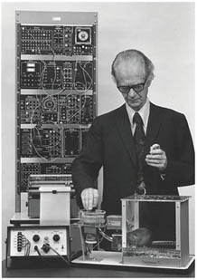
B.F. Skinner
B.F. Skinner is the most famous of the Behaviorists. He is famous for operant conditioning. Operant conditioning (aka shaping) is learning through reinforcements (rewards) and punishments.

Slide 40
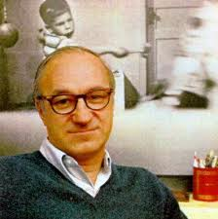
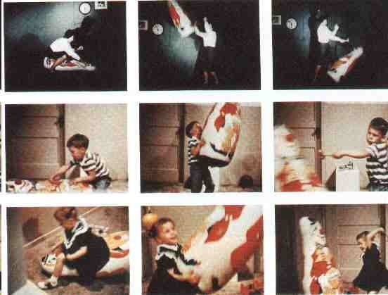
Behaviorism
Albert Bandura did a famous experiment that said our behavior does not have to be classically conditioned or operant conditioned. We can simply observe behavior and copy it.

Slide 41
Behaviorism
The behavioral perspective can explain why people get addicted to gambling (positive reinforcement)
Why students don’t wear their id badge (rewards of the adrenaline rush?)
Why that girl won’t call you anymore (How was she reinforced for calling you?)

Slide 42
Behaviorism Summary
Behaviorism says we do what we do because of classical conditioning, operant conditioning or we simply learn the behavior from watching or copying it.
In its extreme, they think we are simply rats in a cage pressing buttons. WE HAVE NO FREE WILL!

Slide 43

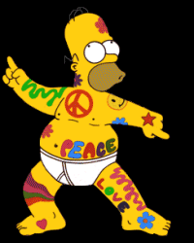

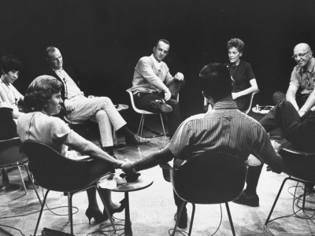
Humanism

Slide 44

Humanistic
Humanism came about in the 1960s in reaction to psychoanalysis and behaviorism. Humanistic psychology was instead focused on each individual’s potential and stressed the importance of growth and self-actualization. The fundamental belief of humanistic psychology was that people are innately good.
We are not rats in a cage! We are not id-driven animals! We are humans with free will.

Slide 45
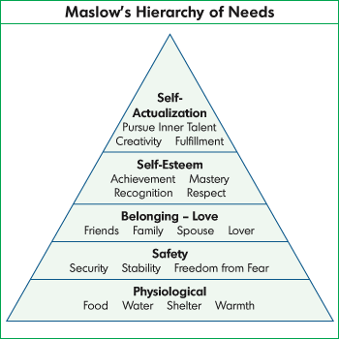
Humanism
Abraham Maslow said we have a hierarchy of needs

Slide 46
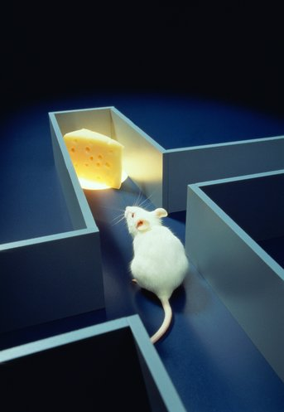
Cognitive Psychology

Slide 47
Cognitive Perspective
What does the word cognitive mean? How about cognition? Recognition?
It is the study of how people perceive, remember, think, speak, and solve problems.
Cognitive therapy is about changing the maladaptive thoughts of a person.

Slide 48
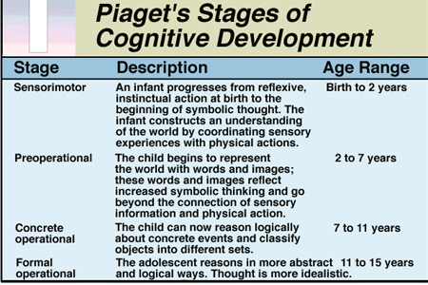
Cognitive Psychologists
Jean Piaget studied cognitive development in children.

Slide 49
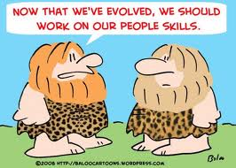
Evolutionary Psychology
Evolutionary psychology examines psychological traits — such as memory, perception, or language — from a modern evolutionary perspective. It seeks to identify which human psychological traits are evolved adaptations, that is, the functional products of natural selection or sexual selection

Slide 50
Evolutionary Psychology
This branch explains why humans do what they do in terms of adaptive value (survival of the species. Why do women usually prefer the guy on the right for long-term relationships?

Slide 51
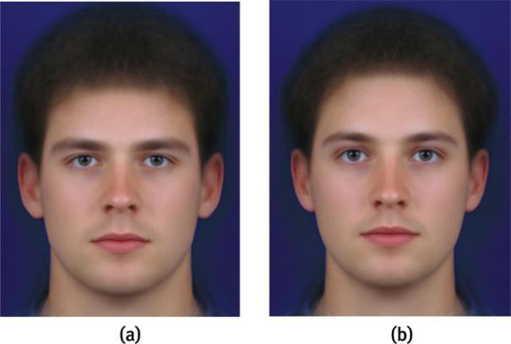

Slide 52

Biological Perspective
This perspective is among the most respected right now. They focus on our brain, nervous system, neurotransmitters and hormones to explain our behaviors.

Slide 53
Sociocultural Perspective
The work of Lev Vygotsky (1934) has become the foundation of much research and theory in cognitive development over the past several decades, particularly of what has become known as sociocultural theory.
Vygotsky's sociocultural theory views human development as a socially mediated process in which children acquire their cultural values, beliefs, and problem-solving strategies through collaborative dialogues with more knowledgeable members of society.

Slide 54
Sociocultural Perspective
Vygotsky's theory is comprised of concepts such as culture-specific tools, private speech, and the Zone of Proximal Development.
Vygotsky's theories stress the fundamental role of social interaction in the development of cognition (Vygotsky, 1978), as he believed strongly that community plays a central role in the process of "making meaning."

Slide 55
Sociocultural Perspective
Unlike Piaget's notion that childrens' development must necessarily precede their learning, Vygotsky argued, "learning is a necessary and universal aspect of the process of developing culturally organized, specifically human psychological function" (1978, p. 90). In other words, social learning tends to precede (i.e., come before) development.

Slide 56
Research Methods in Psychology

Slide 57
Lecture Outline
Experimental Research
Descriptive Research
Correlational Research

Slide 58
Research Concepts
Psychologists are interested in determining the causes of mental events and behaviors
“What is the impact (effect) of divorce on children?”
Issues in Theory:
Systematic way of organizing observations
Hypotheses are proposed relations between variables (cause-effect relationships)
Variable: Any phenomenon that can vary along some dimension
Continuous: varies continuously (body weight)
Categorical: can take on fixed values (gender)

Slide 59
Defining Experiments
Experiments ask whether systematic variation in one variable produces variation in another variable
Independent variable (IV): Manipulated by experimenter
Dependent variable (DV): Participants response
Example: The effect of coffee on academic achievement.
IV: Coffee
DV: Academic achievement

Slide 60
Issues in Experimental Research
Control group: A group that is similar to the experimental group, except that it has not been exposed to the treatment.
Experimental group :exposed to independent variable or conditions expected to create change.

Slide 61
Full population of interest
Randomly assign into control and experimental groups
Experimental group
Control group

Slide 62
Limitations of Experimental Research
Complex real-world issues may not be easily studied in the laboratory
The focus of experimental psychology is off-base: The interpretative stance suggests that we should strive to understand the personal meanings that govern behavior rather than focus on predicting behavior

Slide 63
Descriptive Research
The descriptive approach seeks to describe phenomena rather than to manipulate variables
Methods of descriptive research:
Case studies
Naturalistic observation
Survey research

Slide 64
Case Studies
An in-depth study of the behavior of one person or a small group
Used when large numbers of subjects are not available
Often used in clinical research
Freud’s case study approach
Drawbacks include
Small sample size (limit to generalizability)
Susceptibility to researcher bias

Slide 65
Naturalistic Observation
In-depth study of a phenomenon in its natural setting
Examples include:
Study of primate behavior in the wild
Piaget’s study of the cognitive development of his own children
Advantage: Naturalistic studies have good generalizability
Disadvantages:
Observation per se can alter behavior
Observational technique cannot infer cause of behavior

Slide 66
Survey Research
Survey technique asks questions of large numbers of persons to gain information on attitudes and behavior
Two approaches:
Questionnaires
Interviews
Disadvantages of survey approach:
Sampling issues
People may not respond accurately

Slide 67
Correlational Research
Aim of the correlational approach is to determine the degree to which 2 or more variables are related
Can determine association between data from experiments, case studies, or surveys
Calculate the correlation coefficient (r)
Values range from -1 through 0 through +1
Negative correlations: High values of one variable are associated with low values of the other variable
Correlational studies do NOT establish causality

Slide 68
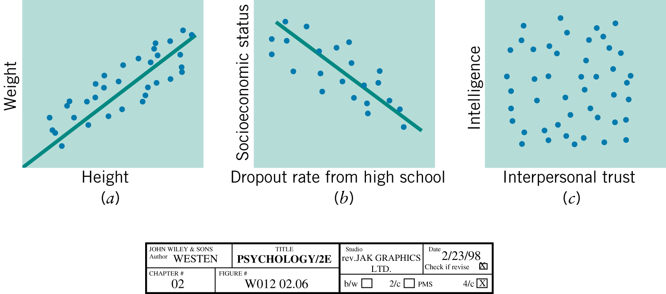
The Correlation Coefficient

Slide 69
Ethical Principles of Research
Ethics in research with human participants
-Freedom from coercion
-Informed consent
-Limited deception
-Adequate debriefing
-Confidentiality

Slide 70
Ethical Principles of Research
Ethics of research with nonhuman animals
-Necessity
-Health
-Humane treatment

Slide 71
UNIT 2
Sensation and Perception

Slide 72

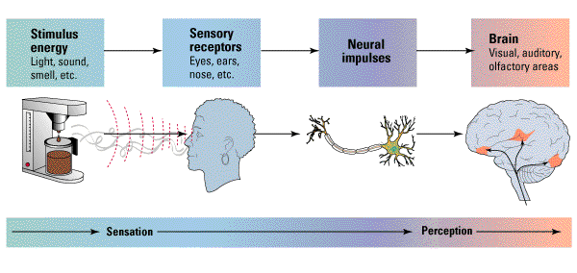
Sensation and perception

Slide 73
Let’s begin with some basic definitions…
2.1. Sensation
Sensation – detecting physical energy in environment and encoding it as neural signals. Neurons transmit the information from the sense organ to the brain.
It is the registration of information

Slide 74
Transduction
The process of changing physical energy into signal process where our neural system under is called transduction.
Transduction is the translation of physical energy into electrical signals (neural signals) by specialized receptor cells and the transmission of this to brain.
All senses involve something called receptor cells. Their job is to transduce (transform or even “translate”) physical stimulation/physical energy from the environment into electrochemical messages that can be understood by the brain.

Slide 75
Cont.…
Communication between the brain & the rest of the body (& between different regions of the brain) occurs via neuron. We recently learned how communication between neurons occurs electrochemically (within neurons: electrical; between neurons: chemical). So the brain’s “language” is electrochemical!

Slide 76
Measuring the Sensitivity of Senses
Absolute Threshold
Smallest amount of energy/stimulation that can reliably be detected 50% of time.
Is the minimum stimulation needed to detect a particular stimulus

Slide 77
Absolute thresholds
chapter 6
If we have normal sensory abilities
Vision
A single candle flame from 30 miles /48 km on a clear night
Hearing
The tick of a watch from 20 feet/6 meter in total quiet
Smell
One drop of perfume in a 6-room apartment
Touch
The wing of a bee on the cheek, dropped from 1 cm
Taste
One teaspoon of sugar in 2 gallons /7.7 liters of water
Notes:
Here are some reported absolute thresholds for the different modalities.

Slide 78
Cont.
. Difference Threshold /Just Noticeable Difference (JND)/
Smallest difference that can be detected when 2 stimuli are compared. E.g., a person might be asked to compare the weight of two blocks or the brightness of two lights or the saltiness of two liquids.
Noise, experience, fatigue, expectation and motivation of the person affect the detection of the threshold.

Slide 79
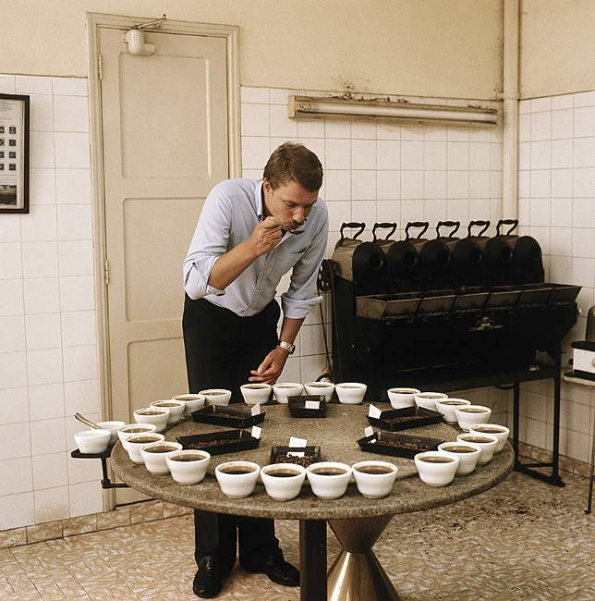
Subliminal Threshold
Subliminal Threshold: When stimuli are below one’s absolute threshold for conscious awareness (0-49% chance of detecting a stimulus) .
Kurt Scholz/ Superstock

Slide 80
Subliminal Threshold cont…
It is stimulation below absolute threshold that imperceptibly/dimly printed in individual person's mind without his/her awareness.

Slide 81
Attributes of Sensation:
Sensory Deprivation- is the absence of normal level of sensory stimulation.
Human brain requires a minimum amount of sensory stimulation in order to function normally. If it is too low it is bad for the brain to function properly.
. Sensory Overload- is experiencing too much amount of stimulus from the environment. This is also bad for the brain to function properly.
- Generally too little stimulation (sensory deprivation) and too much stimulation (sensory overload) can lead to fatigue and mental confusion.

Slide 82

Sensory Adaptation
Diminished sensitivity as a consequence of constant stimulation.
Put a band aid on your arm and after awhile you don’t
sense it. You smell a bad odor in a room, but…

Slide 83
Attributes of sensation cont….
Sensory Interaction: - refers to the principle that one sense may influence another, as when the smell of food influences its taste.
Sensory Restriction: people temporarily or permanently deprived of their senses typically compensate by becoming more acutely aware of information from the other senses.
the reduction of sensory input often evokes a heightened sensitivity to all forms of sensation.

Slide 84
2.2. Perception and Perceptual Process
A sensation may be combined with other sensations and your past experience to yield a perception.
Perception – processing of information done by the brain – mental processes that organize and interpret sensory information that has been transmitted to the brain.
Characteristics of Perception
It is one’s personal interpretation of an external event
It is the result of previous experiences

Slide 85
Cont.…
It is greatly influenced by goals
It depends upon the normal functioning of sense organs.
It is selective and affected by our organization.
Perception involves three basic processes:
1. Selective Attention
2. Organization
3. Interpretation.

Slide 86
Cont.….
1. Selective Attention
The first step in perception is selective attention in which we select the stimuli to which we will attend.
At any given moment, our sense organs are bombarded by a multitude of stimuli; yet we perceive only a few of them clearly.
There are three groups of factors that influence the process of selective attention.

Slide 87
i) Environmental/Stimulus Factors
Intensity: The more intense the stimulus the more it will be attended. A bright color will attract us more than a dull one.
Size: We tend to notice larger compared to smaller ones.
Contrast: What contrasts with the surrounding environment attracts attention easily. For example a banana in a bowel of oranges.
Repetition: A fleeting stimulus will not catch our attention as easily as one, which is repeated. That is, objects repeatedly seen attract attention

Slide 88
Movement: Something, which moves, is more likely to attract attention than something stationary.
Novelty: A sudden or unexpected stimulus is likely to catch our attention more easily than one we have been expecting or that we have encountered.
ii) Psychological Factors
Motives and needs: If you are hungry you give attention on TV commercials for Pizza or hamburger than others notice.
Emotions: If you are lonely you give attention for couples and consider as if all are happy
Personality and Interests: Individuals give attention on things they are interested. E.g. Husband may watch game while his wife may listen to music in the stadium.
Set or expectancy: Set refers to the idea that you may be “ready” and “Primed for” certain kinds of sensory input.

Slide 89
iii) Physiological factors:
Specialized cells in brain called feature detectors/ analyzers make us to respond only to certain sensory information
Characteristics of Attention
The process of attention divides your field of experience in to a focus and a margin.
A focus: Events that we perceive clearly are at the focus of experience.
A margin: Events ( items) that are perceived dimly; we may be aware of their presence, but only vaguely so. These items are in the margin of attention (experience).

Slide 90
2. Organization in Perception
The process by which we structure the input from our sensory receptors is called perceptual organization
Once we have completed our selection of incoming information, we must organize this information into patterns or principles that will help us to understand the world.

Slide 91
Contours in Form Perception
Contours are formed whenever a marked difference occurs in the brightness or color of the background.
If you, for instance, look at a piece of paper that varies continuously in brightness from white at one border to black at the opposite border, you will perceive no contour.
In general, contours give shape to the objects in our visual world because they mark one object off from another or they mark an object off from the general ground.

Slide 92


Forms of Perception: Gestalt principles
Proximity
Things close to one another are grouped together
Closure
The brain tends to fill in gaps to perceive complete forms

Slide 93

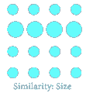

Forms of Perception: Gestalt principles cont.
Similarity
Things that are alike are perceived together
Continuity
Seeing continuity in lines that could be interpreted as either continuous or abruptly shifting in direction.

Slide 94
Figure-Ground
Figure-Ground Organization: Inborn part of a stimulus stands out as a figure (object) against a less prominent background (ground)
Reversible Figure: Figure and ground that can be reversed

Slide 95
1. Figure-Ground Relationships
It says organization of visual field in to objects (the figure) that stand out from their surrounding (the ground).
E.g. the Jet flying across the sky, the airplane is the figure and the sky is the ground.
Figures are closer, more easily remembered and seem to have a shape. If they move their parts move together relative to the background.
In contrast grounds are formless, farther a way and stationary.
Some times the relationship between figure and ground is more ambiguous and produces reversible figures and grounds. E.g. military uniform

Slide 96

Gestalt principles cont.

Slide 97
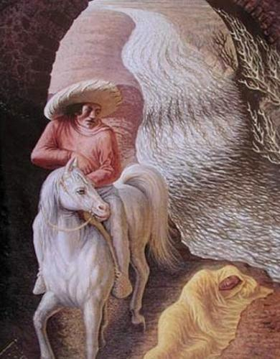
Related Pictures

Slide 98
Depth perception
It is expressed as the ability to judge the distance of objects.
Depth perception depends on the use of binocular cues and monocular cues
There are two kinds of binocular cues: retinal disparity and convergence.
The two kinds of binocular cues require the interaction of both eyes.
Retinal disparity is, the degree of difference between the image of an object that are focused on the two retinas.

Slide 99
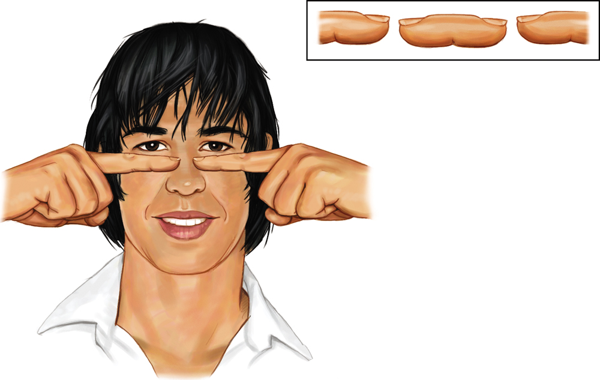
Binocular Cues
Retinal disparity: Images from the two eyes differ. Try looking at your two index fingers when pointing them towards each other half an inch apart and about 5 inches directly in front of your eyes. You will see a “finger sausage” as shown in the inset.

Slide 100
Cont.
The closer the object, the greater is the retinal disparity.
The second binocular cue to depth is convergence, the degree to which the eyes turn inward to focus on an object.
As you can confirm for yourself, the closer the objects are the greater the convergence of the eyes.
Binocular cues require two eyes, whereas monocular cues require only one.

Slide 101
Cont.
This means that even people who have lost sight in one eye may still have good depth perception.
One monocular is accommodation, which is the change in the shape of the lens that lets you focus the image of an object on the retina. It is the tendency of the lens to change its shape, or thickness, in response to objects near or far away.
A second monocular cue is motion parallax, the tendency to perceive ourselves as passing objects faster when they are closer to us than when they are farther away.

Slide 102
Cont.
You will notice this when you drive on a rural road. You perceive yourself passing nearby telephone poles faster than you are passing a farmhouse.
The remaining monocular cues are called pictorial cues because artists use them to create depth in their drawings and paintings.
Leonardo da Vinci (consult page 35 of the module for the details)

Slide 103
Cont.
An object that overlaps another object will appear closer, a cue called Interposition.
Because your psychology professor overlaps the blackboard, you know that she or he is closer to you than the blackboard is.

Slide 104

Monocular Cues
Interposition: Objects that occlude (block) other objects tend to be perceived as closer.
Rene Magritte, The Blank Signature, oil on canvas,
National Gallery of Art, Washington. Collection of
Mr. and Mrs. Paul Mellon. Photo by Richard Carafelli.

Slide 105
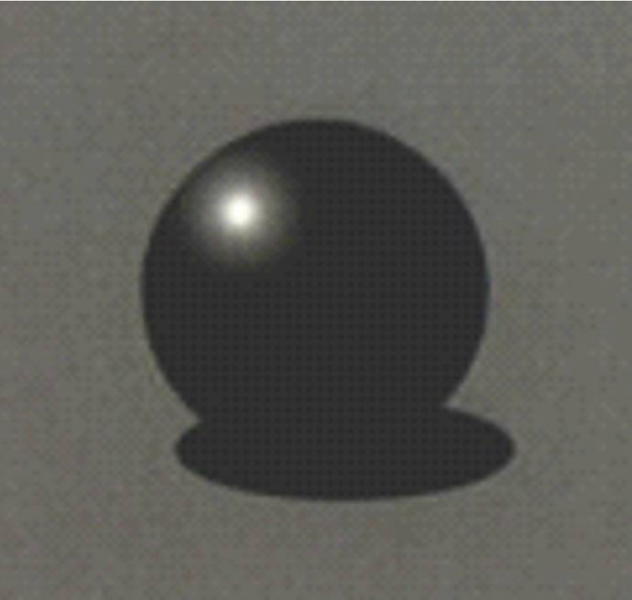

Cont.
Light and Shadow: Nearby objects reflect more light into our eyes than more distant objects. Given two identical objects, the dimmer one appears to be farther away.
From “Perceiving Shape From Shading” by Vilayaur
S. Ramachandran. © 1988 by Scientific American, Inc.
All rights reserved.

Slide 106
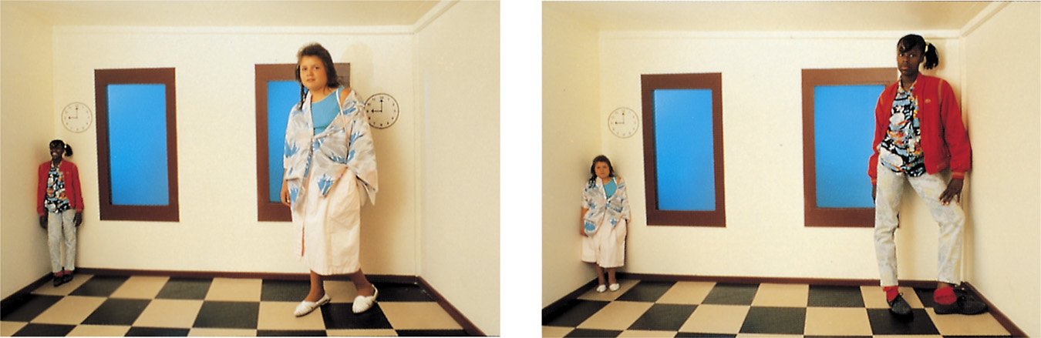
Size-Distance Relationship
Both girls in the room are of similar height. However, we perceive them to be of different heights as they stand in the two corners of the room.
Both photos from S. Schwartzenberg/ The Exploratorium

Slide 107
Perceptual Constancies
Size Constancy – perceive familiar objects as having a constant size even when its retinal image becomes larger or smaller as we get closer to or farther from it.
Shape Constancy – perceive familiar objects as having constant shape even though the shape of the retinal image produced by an object changes when our point of view changes.

Slide 108
Cont.
3. Brightness Constancy – see objects as having relatively constant brightness even though the amount of light they reflect changes as the over all level of illumination changes.
4. Location Constancy –perceive stationary objects as remaining in the same place despite the retinal image moves about as we move our eyes.
5. Color Constancy – perceive the color of objects as stable despite the changing illumination.

Slide 109
3. Interpretation
Generating meaning from sensory experience is the task of perceptual interpretation.
Perceptual interpretation lies at the intersection of sensation and memory, as the brain interprets current sensations in light of past experience.
Different individual’s might observe the same object. But they interpreter differently based on their prior experience.

Slide 110
Cont.…
Like selection, the process of interpretation is also influenced by several factors. The following can be examples.
Beliefs: What we hold to be true about the world can affect the interpretation of ambiguous sensory signals.
Emotions: Our emotions or moods also influence our interpretations of sensory information.
Expectations: Experience with the environment often affects how we perceive the world by creating perceptual expectations.

Slide 111
Cont.…
These expectations called perceptual set make particular interpretations more likely. Two aspects of perceptual set are the current context and enduring knowledge structures.
Extrasensory Perception (ESP)---Parapsychology
Eyes, ears, mouth, nose, and skin- we rely on these organs for our experience of the external world.
Some people, however, claim they can send and receive messages about the world without relying on the usual sensory channels, by using Extrasensory Perception (ESP).

Slide 112
Cont.…
They reported that ESP experiences fall into four general categories:
Telepathy is a direct communication from one mind to another without the usual visual, auditory and other sensory signals.
Clairvoyance is the perception of an event or fact without normal sensory input.
Precognition is the perception of an event that has not yet happened.
Psychokinesis is the ability to affect the physical world purely through thought. Persons with such abilities claim to move or affect objects without touching them.

Slide 113
UNIT-3
LEARNING and Theories of Learning

Slide 114
3.1. Learning
3.1.1. Meaning of Learning
“Learning is defined as a relatively permanent change in behavior as a result of experience and training.”
The following points are revealed from this definition
Learning has enduring nature. It results in relatively permanent modification of behavior.
Learning is a change in knowledge or behavior. This change does not include changes due to illness, fatigue, intoxication, hunger, maturation and so on.
Learning is an internal mental activity that cannot be directly observable but manifests in the activities of the individual.
Learning depends on experience or practice. Learning results only those changes that occur as a result of the interaction of a person with his/her environment.

Slide 115
3.1.2. Main Characteristics of Learning
1. Learning is growth. A child grows both mentally and physically through his/her daily activities. Therefore, we can say that learning is growth through experience.
2. Learning is adjustment. Learning helps an individual to adjust himself/herself to the new situations.
3. Learning is organizing experience. Learning is not merely addition to knowledge. It is the reorganization of experience.
4. Learning is purposeful. All true learning is based on purpose. We don’t learn anything and everything that comes in our way in a haphazard manner.
5. Learning is intelligent. Meaningless efforts do not produce permanent result. Only efforts made intelligently have lasting effects.

Slide 116
6. Learning is active. Learning does not take place without a purpose and self activity. The principle of learning by doing is the main principle which has been recommended by all modern educationalists.
7. Learning is both individual and social. It is an individual and social activity.
8. Learning is the product of environment. Environment plays an important role in the growth and development of the individual.
9. True learning affects the conduct of the learner. There is a change in the mental structure of the learner after every experience.

Slide 117
3.1.3. Principles of learning
There are important principles that help explaining how learning occurs effectively. Some of the most important principles of learning are as follows:
1. Individuals learn best when they are physically,
mentally, and emotionally ready to learn
2. Students learn best and retain information longer
when they have meaningful practice and exercise
3. Learning is strengthened when accompanied by a
pleasant or satisfying feeling, and that learning is weakened when associated with an unpleasant feeling

Slide 118
4. Things learned first create a strong impression in
the mind that is difficult to erase.
5. Things most recently learned are best remembered
6. The principle of intensity implies that a student will
learn more from the real thing than from a substitute.
7. Individuals must have some abilities and skills that
may help them to learn.
8. Things freely learned are best learned - the greater
the freedom enjoyed by individuals, the higher the intellectual and moral advancement.

Slide 119
3.1.4. Factors Influencing Learning
Some of the factors that affect learning are the following.
1. Motivation: The learner‘s motivation matters the effectiveness of learning. The stronger and clearer the motives for learning, the greater are the effort to learn.
2. Maturation: Neuro-muscular coordination is important for learning a given task. Example, The child has to be mature before she/he is able to learn.
3. Health condition of the learner: The learner should be in a good health status to learn. Example- Sensory defects, malnutrition, toxic conditions of the body, loss of sleep and fatigue hinder effective learning.
4. Psychological wellbeing of the learner: individual‘s psychological states like worries, fears, feelings of loneliness and inferiority hinders learning. Whereas self-respect, self-reliance, and self-confidence are necessary for effective learning.

Slide 120
5. Good working conditions: absence or presence of fresh air, light, comfortable surroundings, moderate temperature, absence of distractions like noise and learning aids determine learning effectiveness.
6. Background experiences: having background experiences affect effectiveness of learning.
7. Length of the working period: Learning periods should neither be too short nor too long. Long learning time sets fatigue and reduces effectiveness in learning.
8. Massed and distributed learning: Learning that spreads across time with reasonable time gaps brings better results compared with crammed learning that occurs at once or within short span of time.

Slide 121
3.2. THEORIES OF LEARNING and Their Applications
Behavioral views of learning
Social learning theory
Cognitive views of learning
3.2.1. Behavioral views of learning
S-R theories without reinforcement
Pavlov’s Classical Theory of Learning
Watson’s Theory of Learning
Guthrie’s Theory of Learning
S-R theories with reinforcement
Skinner’s theory of operant conditioning
Thorndike’s Theory of Learning

Slide 122
3.2.1.1. Pavlov’s Classical Conditioning / Respondent/ Conditioning or type 1 Learning/
Classical conditioning theory represents a process in which a natural stimulus pairing with a neutral stimulus, the neutral stimulus acquires all the characteristics of a natural stimulus.
It is a type of learning in which a neutral stimulus comes to bring about a response after it is paired with a stimulus that naturally brings about that response.
It is also called substitution learning because it involves substituting a neutral stimulus in place of natural stimulus.
Stimulus anything in the environment that one can respond to.
Responses  any behavior or action towards a stimulus.

Slide 123
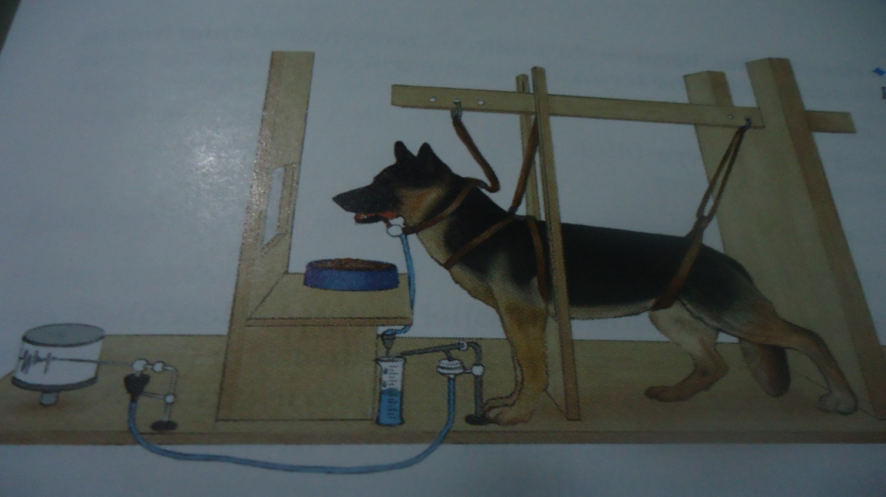
Pavlov’s Classical Conditioning Experiment
Before conditioning
Bell (Neutral stimulus) or CS No salivation.
Food (natural stimulus) or UCS salivation (UCR).
During conditioning
Bell (CS) + food (UCS) salivation (UCR).
After conditioning
Bell (CS) salivation (CR).

Slide 124
Basics of Classical Conditioning
1. Neutral Stimulus- A stimulus that, before conditioning, does not naturally bring about the response of interest
2. Unconditioned stimulus (UCS) - is the natural stimulus that triggers a response automatically and reflexively.
It is unlearned, internal and consistently elicits a response.
3. Unconditioned response (UCR) - the automatic response to unlearned stimulus (UCS) reflexively but not learned and it works naturally.
4. Conditional stimulus (CS) - Originally neutral stimulus that through association (learning), gains the power of eliciting a response.
5. Conditioned response (CR) - is the response to the CS.
- It is process of developing a learned response and it is similar to UCR.

Slide 125

E.g. we can take white rat (CS), Loud noise (UCS) and fear of the child called “Little Albert”
- White rat leads to No response
- Loud sound elicit UCR (fear)
-White rat + loud noise with several pairings fear
White rat (CS) elicit fear (CR)

Slide 126
Principle of classical conditioning
①. Acquisition: process of developing learned response.
②. Extinction: is the diminishing of learned response, when the UCS does not follow a CS.
③. Spontaneous Recovery: The reappearance of the CR after a rest period suddenly stimulated by the CS.

Slide 127
Generalization and Discrimination
Despite differences in color and shape, to most of us a rose is a rose is a rose. The pleasure we experience at the beauty, smell, and grace of the flower is similar for different types of roses.
Pavlov noticed a similar phenomenon. His dogs often salivated not only at the ringing of the bell that was used during their original conditioning but at the sound of a buzzer as well.

Slide 128
Such behavior is the result of stimulus generalization. Stimulus generalization occurs when a conditioned response follows a stimulus that is similar to the original conditioned stimulus. The greater the similarity between two stimuli, the greater the likelihood of stimulus generalization. Little Albert, who, as we mentioned earlier, was conditioned to be fearful of white rats, grew afraid of other furry white things as well.
However, according to the principle of stimulus generalization, it is unlikely that he would have been afraid of a black dog, because its color would have differentiated it sufficiently from the original fear-evoking stimulus.

Slide 129
The conditioned response elicited by the new stimulus is usually not as intense as the original conditioned response, although the more similar the new stimulus is to the old one, the more similar the new response will be.
On the other hand, stimulus discrimination occurs if two stimuli are sufficiently distinct from one another that one evokes a conditioned response but the other does not. Stimulus discrimination provides the ability to differentiate between stimuli.
For example, our ability to discriminate between the behavior of a growling dog and that of one whose tail is wagging can lead to adaptive behavior—avoiding the growling dog and petting the friendly one.

Slide 130
To make conditioning effective;
- The time laps between the presentations of the two stimuli (CS & UCS) should be small ranging from half to a few seconds.
- The CS should present before the presentation of the UCS (sometimes simultaneously).
Different types of conditioning can be employed in classical conditioning based on time and order of CS and UCS.
a) Delayed conditioning: refers to presenting the CS first and letting to remain at least until the onset of the UCS. It produces strong conditioning.

Slide 131
Cont.
b. Trace conditioning: refers to presenting the conditioned stimulus first and ending before the onset of the UCS. It produces moderately strong conditioning.
c. Simultaneous conditioning: refers to beginning and ending of the CS and the UCS together. It produces weak conditioning.
d. Backward conditioning: is a conditioning in which the onset of the UCS precedes the onset of the CS. It is mostly unsuccessful principle.

Slide 132
Operant conditioning is learning in which a voluntary response is strengthened or weakened, depending on its favorable or unfavorable consequences. When we say that a response has been strengthened or weakened, we mean that it has been made more or less likely to recur regularly.
Unlike classical conditioning, in which the original behaviors are the natural, biological responses to the presence of a stimulus such as food, water, or pain, operant conditioning applies to voluntary responses, which an organism performs deliberately to produce a desirable outcome.
The term operant emphasizes this point: The organism operates on its environment to produce a desirable result. Operant conditioning is at work when we learn that toiling industriously can bring about a raise or that studying hard results in good grades.

Slide 133
Operations in Operant Conditioning
Shaping:- refers to the judicious use of selective reinforcement to bring certain desirable changes in the behavior of the organism.
For a response to be reinforced, it must first occur. But, suppose you train a child to use a knife and a fork properly. Such behaviors, and most others in everyday life, have almost no probability of appearing spontaneously.
The operant solution for this is shaping. Shaping is an operant conditioning procedure in which successive approximations of a desired response are reinforced.
In shaping you start by reinforcing a tendency in the right direction. Then you gradually require responses that are more and more similar to the final desired response.

Slide 134
Extinction: In operant conditioning, extinction refers to the gradual weakening and disappearance of the conditional response if it is not reinforced. Skinner noted this principle by accident when the pellet dispenser jammed. Thus, the rat’s responses (pressing the bar) produced no reinforcements.

Slide 135
Reinforcement: the central concept of operant conditioning
Reinforcement is the process by which a stimulus increases the probability that a preceding behavior will be repeated.
A reinforcer is any stimulus that increases the probability that a preceding behavior will occur again.
Hence, food is a reinforcer because it increases the probability that the behavior will take place.
What kind of stimuli can act as reinforcers? Bonuses, toys, and good grades can serve as reinforcers—if they strengthen the probability of the response that occurred before their introduction.

Slide 136
Positive Reinforcers, Negative Reinforcers, and Punishment
In many respects, reinforcers can be thought of in terms of rewards; both a reinforcer and a reward increase the probability that a preceding response will occur again.
But the term reward is limited to positive occurrences, and this is where it differs from a reinforcer—for it turns out that reinforcers can be positive or negative.
A positive reinforcer is a stimulus added to the environment that brings about an increase in a preceding response. If food, water, money, or praise is provided after a response, it is more likely that that response will occur again in the future.
The paychecks that workers get at the end of the week, for example, increase the likelihood that they will return to their jobs the following week.

Slide 137
In contrast, a negative reinforcer refers to an unpleasant stimulus whose removal leads to an increase in the probability that a preceding response will be repeated in the future.
For example, if you have an itchy rash (an unpleasant stimulus) that is relieved when you apply a certain brand of ointment, you are more likely to use that ointment the next time you have an itchy rash. Using the ointment, then, is negatively reinforcing, because it removes the unpleasant itch. Similarly, if your iPod volume is so loud that it hurts your ears when you first turn it on, you are likely to reduce the volume level. Lowering the volume is negatively reinforcing, and you are more apt to repeat the action in the future when you first turn it on.

Slide 138
Negative reinforcement, then, teaches the individual that taking an action removes a negative condition that exists in the environment.
Like positive reinforcers, negative reinforcers increase the likelihood that preceding behaviors will be repeated.
Note that negative reinforcement is not the same as punishment.
Punishment refers to a stimulus that decreases the probability that a prior behavior will occur again.
There are two types of punishment: positive punishment and negative punishment, just as there are positive reinforcement and negative reinforcement. (In both cases, “positive” means adding something, and “negative” means removing something.)

Slide 139
Positive punishment weakens a response through the application of an unpleasant stimulus. For instance, spanking a child for misbehaving or spending ten years in jail for committing a crime is positive punishment.
In contrast, negative punishment consists of the removal of something pleasant. For instance, when a teenager is told she is “grounded” and will no longer be able to use the family car because of her poor grades, or when an employee is informed that he has been demoted with a cut in pay because of a poor job evaluation, negative punishment is being administered.
Both positive and negative punishment result in a decrease in the likelihood that a prior behavior will be repeated.

Slide 140
Schedules of reinforcement: timing life’s rewards
The world would be a different place if poker players never played cards again after the first losing hand, fishermen returned to shore as soon as they missed a catch, or telemarketers never made another phone call after their first hang-up. The fact that such unreinforced behaviors continue, often with great frequency and persistence, illustrates that reinforcement need not be received continually for behavior to be learned and maintained.
In fact, behavior that is reinforced only occasionally can ultimately be learned better than can behavior that is always reinforced.

Slide 141
When we refer to the frequency and timing of reinforcement that follows desired behavior, we are talking about schedules of reinforcement.
Behavior that is reinforced every time it occurs is said to be on a continuous reinforcement schedule;
If it is reinforced some but not all of the time, it is on a partial (or intermittent) reinforcement schedule.
Although learning occurs more rapidly under a continuous reinforcement schedule, behavior lasts longer after reinforcement stops when it is learned under a partial reinforcement schedule

Slide 142
Although many different partial reinforcement schedules have been examined, they can most readily be put into two categories:
Schedules that consider the number of responses made before reinforcement is given, called fixed-ratio and variable-ratio schedules, and those that consider the amount of time that elapses before reinforcement is provided, called fixed-interval and variable-interval schedules.

Slide 143
Fixed- and Variable-Ratio Schedules
In a fixed-ratio schedule, reinforcement is given only after a specific number of responses. For instance, a rat might receive a food pellet every tenth time it pressed a lever; here, the ratio would be 1:10. Similarly, garment workers are generally paid on fixed-ratio schedules: They receive a specific number of dollars for every blouse they sew. Because a greater rate of production means more reinforcement, people on fixed-ratio schedules are apt to work as quickly as possible.

Slide 144
In a variable-ratio schedule, reinforcement occurs after a varying number of responses rather than after a fixed number. Although the specific number of responses necessary to receive reinforcement varies, the number of responses usually hovers around a specific average. Gambling and begging are the two examples of variable ratio schedule, which lead to a high rate of response and resistance to extinction.

Slide 145
Fixed- and Variable-Interval Schedules: The Passage of Time
In contrast to fixed- and variable-ratio schedules, in which the crucial factor is the number of responses, fixed-interval and variable-interval schedules focus on the amount of time that has elapsed since a person or animal was rewarded.
One example of a fixed interval schedule is a weekly paycheck. For people who receive regular, weekly paychecks, it typically makes relatively little difference exactly how much they produce in a given week. Because a fixed-interval schedule provides reinforcement for a response only if a fixed time period has elapsed, overall rates of response are relatively low. This is especially true in the period just after reinforcement, when the time before another reinforcement is relatively great. Students’ study habits often exemplify this reality. If the periods between exams are relatively long (meaning that the opportunity for reinforcement for good performance is given fairly infrequently), students often study minimally or not at all until the day of the exam draws near. Just before the exam, however, students begin to cram for it, signaling a rapid increase in the rate of their studying response. As you might expect, immediately after the exam there is a rapid decline in the rate of responding, with few people opening a book the day after a test.

Slide 146
One way to decrease the delay in responding that occurs just after reinforcement, and to maintain the desired behavior more consistently throughout an interval, is to use a variable-interval schedule. In a variable-interval schedule, the time between reinforcements varies around some average rather than being fixed. For example, a professor who gives surprise quizzes that vary from one every three days to one every three weeks, averaging one every two weeks, is using a variable-interval schedule.
Compared to the study habits we observed with a fixed-interval schedule, students’ study habits under such a variable-interval schedule would most likely be very different. Students would be apt to study more regularly because they would never know when the next surprise quiz was coming. Variable-interval schedules, in general, are more likely to produce relatively steady rates of responding than are fixed-interval schedules, with responses that take longer to extinguish after reinforcement ends.

Slide 147
Implications of Operant Conditioning
v Use reinforcers periodically to extend the desired behavior
v Give reinforces immediately for a desired br of students.
v Use praise and ignore- means praising students who follow rules and ignore rule breakers.
v Carefully and systematically praise students.
v Use the Premack principle (using bait exchange high for low) to reinforce.
v Use shaping - successive approximation, which involves reinforcing progress instead of waiting for perfection.
v Reinforce improvement in accuracy, longer periods of performance and participation to persist the br.
v Use guidelines when reinforce and punish students.
v Use appropriate schedule of reinforcement to persist behavior.

Slide 148
3.2.2. Observational /Social/ Learning Theory
Albert Bandura is the prime proponent of this theory.
Learning takes place through observation, imitation, modeling, mimicking or watching others.
Vicarious learning – learning by seeing the consequence of another persons br.
observing reinforcing consequences (vicarious reinforcement) for that br.
observing a punitive consequence (Vicarious punishment).
Children do not always immediately display behavior learned from models.
This is the evidence that acquisition & performance are not identical.

Slide 149
Steps of observational learning
Bandura mentions four conditions that are necessary before an individual can successfully model the behavior of someone else:
1. Attention – first paying attention to the model
2.Retention – mentally represent to the model’s action in some ways as verbal or visual images or both.
3.Production – showing /acting out/ or performing the behavior
4.Motivation and reinforcement – learners must want to demonstrate what they have learned from the model.
Remember that since these four conditions vary among individuals, different people will reproduce the same behavior differently.

Slide 150
Assumptions of Social Learning Theory
u Reciprocal determinism refers to the interaction of the person, person’s behavior and physical environment.
u People have an agency or ability to influence their own behavior and the environment in a purposeful, goal-directed fashion as opposed to environmental determinism of behaviorism
u Learning can occur without an immediate change
in behavior or more broadly that learning and
the demonstration of what has been learned are
distinct processes.
It also means that students can learn but not
demonstrate that learning until motivated to do so.

Slide 151
Educational Implications of Social Learning Theory
Social learning theory has numerous implications for classroom use
1. Students often learn a great deal simply by observing other people
2. Describing the consequences of behavior can effectively increase the appropriate behaviors and decrease inappropriate ones
3. Modeling provides an alternative to shaping for teaching new behaviors
However, modeling can provide a faster, more efficient means for teaching new behavior than shaping in operant conditioning

Slide 152
4. Teachers and parents must model appropriate behaviors and take care that they do not model inappropriate behaviors
5. Teachers should expose students to a variety of other models.
This technique is especially important to break down traditional stereotypes
6. Students must believe that they are capable of accomplishing school tasks
Thus it is very important to develop a sense of self-efficacy for students.
7.Teachers should help students set realistic expectations for their academic accomplishments

Slide 153
3.2.3. Cognitive Learning Theory
Cognitive learning theorists believe that thought processes have an important effect on learning. Humans often use mental or cognitive abilities when they interact with their environment.
People can manipulate, alter, or change things mentally to examine possible outcomes before they actually do anything.
Developed approaches that focus on the unseen
mental processes that occur during learning, rather than concentrating solely on external stimuli, responses, and reinforcements.

Slide 154
3.2.3.1. Latent Learning
Evidence for the importance of cognitive processes comes from a series of animal experiments that revealed a type of cognitive learning called latent learning.
‘Latent‘ means hidden and thus latent learning is learning that occurs but is not evident in behavior until later, when conditions for its appearance are favorable/rewarded.
It is said to occur without reinforcement of particular responses and seems to involve changes in the way information is processed.
In a classic experiment, Tolman and Honzic (1930) placed three groups of rats in mazes and observed their behavior each day for more than two weeks.

Slide 155
The rats in Group 1 always found food at the end of the maze. Group 2 never found food. Group 3 found no food for ten days but then received food on the eleventh.
The Group 1 rats quickly learned to head straight the end of the maze without going blind alleys, whereas Group 2 rats did not learn to go to the end. But, Group 3 rats were different.
For ten days they appeared to follow no particular route. Then, on the eleventh day they quickly learned to run to the end of the maze. By the next day, they were doing, as well as group one, which had been rewarded from the beginning.
Group three rats had demonstrated latent learning, learning that is not immediately expressed. A great deal of human learning also remains latent until circumstances allow or require it to be expressed.

Slide 156
To cognitive theorists, it seemed clear that the unrewarded rats had learned the layout of the maze early in their explorations; they just never displayed their latent learning until the reinforcement was offered.
Instead, those rats seemed to develop a cognitive map of the maze—a mental representation of spatial locations and directions.
People, too, develop cognitive maps of their surroundings.
For example, latent learning may permit you to know the location of a kitchenware store at a local mall you’ve frequently visited, even though you’ve never entered the store and don’t even like to cook.

Slide 157
3.2.3.2. Insight Learning
It is a cognitive process whereby we reorganize our perception of a problem.
It’s learning to solve a problem by understanding various parts of the problem.
It doesn‘t depend on conditioning of particular behaviors for its occurrence.
Sometimes, for example, people even wake up from sleep with a solution to a problem that they had not been able to solve during the day.
In a typical insight situation where a problem is posed, a period follows during which no apparent progress is made, and then the solution comes suddenly.
What has been learned in insight learning can also be applied easily to other similar situations.

Slide 158
Human beings who solve a problem insightfully usually experience a good feeling called an 'aha' experience.
Wolfgang Kohler studied insight learning in chimpanzees
Kohler placed chimpanzees in certain situations and watched them solve the problems
Ex. Hanging a banana out of the chimpanzee’s reach-
Solution: Monkeys stacked boxes on top of one another to get to the banana
Kohler believed that the monkeys could not have come to the solution without a cognitive understanding of how to solve the problem.

Slide 159
UNIT 4 MEMORY FORGETTING AND ACADEMIC SKILLS

Slide 160
Nature and Definition of Memory
Memory: is the process by which we encode, store & retrieve infn (what was learned earlier).
• Simply memory is remembering previously learned experience.
• Memory process is the mental activities we perform to put infn in the memory, to keep it there & to make use of it later.
• It indicates how infn is represented in memory, how long it lasts & how it is organized.

Slide 161
Process of Memory
Memory process involves three basic steps. These are:
A.Encoding: refers to the process by w/h infn is initially recorded in form usable to memory.
- Transform a sensory input in to a form or a memory code that can be further processed.
B.Storage: involves keeping/maintaining infn in the memory.
- It is the location in memory system in w/h materials are saved.
C. Retrieval: it involves the use of stored infn when it is needed.
- Materials from storage memory brought in to awareness & used.

Slide 162
Structures/Stages/Forms/of memory
According to Atkinson & Sheferin, human memory consists of three different but interacting systems. These are:
• Sensory memory/registrar(SM)
• Short-term memory (STM)
• Long- term memory (LTM)

Slide 163
Structures of Memory
Infn from
Selection Retrieval
the env’t
Decay Decay Forgetting
SM
STM
LTM

Slide 164
1. Sensory Memory/ Registrar (SR)
It is a component of the memory system that receives infn from the env’t.
It is the entryway to memory & the first infn storage area.
The type of infn is a very accurate & complete representation of the env’t but it is unprocessed.
Capacity of SM is very large, more infn than we can possibly handle at once.
Duration if the infn is visual infn it stores in the iconic memory in the form of images for a maximum of one second.
- If the infn is auditory it stores in echoic memory in the form of sound patterns for two seconds.

Slide 165
2. Short Term Memory (STM)
® It holds the contents of our attention.
®Consists of the by-products or end results of perceptual analysis.
®it is also called working/immediate/active/primary memory.
® type of infn in STM are visual images, words sentences & so on received from SM.
® duration of infn in STM is short, about 20 to30 seconds.

Slide 166
® We can overcome the limitation of the infn duration by using rehearsals(1).
- There are two types of rehearsals. These are:
Maintenance Rehearsal – involves repeating the infn in the mind.
 Elaborative Rehearsal – involves associating the infn to d/f things & persons that the person already knows.
­This kind of rehearsal is not only retains infn in the STM but also helps to move infn from STM to LTM.

Slide 167
­Through chunking(2); a piece of grouping small pieces of infn into meaningful larger units.
­The chunk may be a word, a phrase, a sentences even visual images, and it depends on previous experiences.
E.g.From 12 digit no 3,4,5,8,1,2,6,9,6,7,1,5 it is easier to put them in to three chunks like
3458,1269,6715.

Slide 168
3. Long Term Memory
- It is a relatively permanent storage of meaningful infn.
- It holds infn that is well learned.
- Type of infn is facts, events, knowledge, skills, either visual images or verbal units or both.
- Capacity of LTM also has no practical limits.
- Duration of the infn in this memory has no limited time. Or it stores infn for indefinite periods.
-The access of infn from STM is immediate but the access of infn from LTM requires time and effort.

Slide 169
- LTM has two categories. These are:
A, Declarative/Explicit/ Memory - contains the conscious collections of infn such as facts or events that can be verbally communicated. It is divided in to two:
1, Semantic Memory - stores factual knowledge like rules, concepts, words, propositions, & images.
2, Episodic Memory- memories of events & situations from personal experience/life experience/.
B, Non-declarative/Implicit/Memory: - are memories that cannot be brought into conscious & declared, rather they are shown in actions.
- Procedural memory- This memory is a memory of “how to do things”

Slide 170
Serial position effect
 “It states that if you are shown a list of items and then asked immediately to recall them, your retention of any particular item will depend on its position on the list.”
 Primacy effect- best recall of items at the beginning of the list
 Recency effect- best recall of items at the end of the list.
 When retention of all the items is plotted, the result will be a U-shaped curve.

Slide 171
-The first few items on a list are remembered well b/s STM was relatively “empty” when they are entered, so these items did not have to compete with others to make it into LTM. They were thoroughly processed, so they remain memorable.
- The last items remembered easily b/s they are still sitting in STM.
-The items in the middle of the list are not so well retained because by the time they get into STM, it is already crowded. As a result many of this items drop out of STM before they can be stored in STM.

Slide 172
Forgetting
- It is the apparent loss of infn already stored & encoded in the LTM.
- There are five theories of forgetting.
1. Decay Theory
- It states that memory traces fades with time if they are not accessed now & then.
- Or the trace simply fades away b/s of disuse & the passage of time.
2. Interference Theory
- Forgetting occurs b/s similar items of infn interfere on another in either storage or retrieval.
- There are two forms of interference

Slide 173

Proactive /Forward/ Interference -the infn learned earlier interferes with recall of newer infn/materials/.
Example:- If you call your new girlfriend your old girlfriend’s name.
-Retroactive/Backward/Interference-the new infn interferes with the ability to remember old infn.
Example:- When you finally remember this years locker combination, you forget last years.

Slide 174
3. New Memory for Old/Displacement/Theory
-It states that the new infn entering in the memory can wipe out old infn, just as recording on an audio or videotape will obliterate/wipe out the original material.
- As you continue to store more and more infn at the same time you lose other infn, which was stored before.

Slide 175
4. Motivated Forgetting Theory
 People forget b/s they block from consciousness those memories that are too threatening or painful to live with
 People forget b/s they are motivated to forget/we forget, we forget that we forget/.
5. Cue Dependent Forgetting
When we lack retrieval cues, we may fell as if we have lost the call number for an entry in the mind’s library.
- To remember, we rely on retrieval cues-items of infn that can help us find the specific infn we are looking for.

Slide 176
Improving Memory
Developing good studying habits w/h is scheduled in the comfortable place.
Ø Paying attention:
Ø Encode the infn in more than one way:
Ø Add meaning:
Ø Take your time & Over learn:
Ø Monitor you learning:
Expanding by using illustrations or examples:
Ø Use rehearsals and form Acronyms:
Ø Use the method of loci:

Slide 177
ACADEMIC SKILLS

Slide 178
Time Mnagement
Time management is the abilty to plan and control how someone spends the hours in a day to accomplish his or her goals effectively.
Planning your time allows you to spread your work over sessions, avoid a jam of works, and cope with study stress.
People who practice good time management techniques often find that they:
Are more productive
Have more energy for things they need to accomplish
Feel less stressed
Are able to do the things they want
Get more things done
Relate more positively to others and feel better about themselves

Slide 179
To manage your time more effectively:
Know how you spend time
Set priorities
Use a planning tool
Get organized
Schedule your time appropriately
Delegate – get help from others
Stop procrastinating
Manage external time wasters
Avoid multi-tasking
Stay healthy

Slide 180
Note-taking and Study Skills
How you take notes while your teacher is teaching in class? Can you catch up with him/her?

Slide 181
Conti......
In order to succeed in learning, it is often necessary to take good notes as lecturers often provide you with key information for the course.
There are several strategies which will help you to take good notes.
Getting Organized: Before you go to class, you need to have the necessary materials.
prepare yourself and select the best approach to take notes.
Before Class: This strategy provides familiarity with terms, ideas, and concepts discussed in lecture.

Slide 182
During Class
guidelines and methods to take notes during class
Date your notes
Keep the objective/theme of the class in mind
Record notes in your own words
Make your notes brief and focus on the main points

Slide 183
Common Note Taking Methods
Cornell Method: breaking the note page into three sections (Cue column, note-taking column and summary)
Outlining: recording the main ideas of the lecture to the left margin of the page in your exercise book.
Charting: charting is a good strategy for courses that require comparisons/contrasts of specific dates, places, people, events, importance and how the information relates.

Slide 184
After Class
Remain in the classroom or find a quiet space close by and review notes.
To solidify your understanding and connect new concepts with previous concepts review your notes as soon as possible following class.
Connect with another member of the class and create an interactive discussion about the lecture
Visit your professor during office hours with questions.
Instead of recopying your notes, record yourself reviewing what you wrote
Test-Taking Skill
Some suggestions that can help students in doing tests.
Attend all classes
Take organized and clear lecture notes

Slide 185
Conti...
Plan your study time and set study goals
Use SQ3R(Survey, Question, Read, Revise and Recite) study style
Use memorizing techniques
Divide the review material into logical sections and concentrate on one at a time.
Organize the information you must remember
Know your teacher
Make your presence known in class by your courtesy, cooperation and willingness to learn
Ask questions to increase your understanding of course material
Make use of tutoring services and student support centers of the college

Slide 186
Conti......
Separate review time from daily assignments
Start reviewing systematically and early, not just the night before the test
Practice predicting and answering test questions.
Learn test-taking terms and strategies
Examine previous tests
Find out what kind of a test it will be: objective, essay, or a combination of both.
Find out when and where the test will be given.
Get plenty of sleep the night before the exam.
Get up early enough to avoid rushing and to eat a healthy breakfast.
Tell yourself you will do well.

Slide 187
Test Anxiety and Overcoming Test Anxiety
Test anxiety is a negative mood state characterized by bodily symptoms of physical tension and by apprehension about a test/exam going to take place in the future.
Symptoms of severe test anxiety
Physical - headaches, nausea or diarrhea, extreme body temperature changes, excessive sweating, shortness of breath, light-headedness or fainting, rapid heartbeat, and/or dry mouth
Emotional - excessive feelings of fear, disappointment, anger, depression, uncontrollable crying or laughing, feelings of helplessness
Behavioral - fidgeting, pacing, substance abuse, avoidance
Cognitive - racing thoughts, going blank, difficulty in concentrating, negative self-talk, feelings of dread, comparing self with others, and difficulty in organizing thoughts.

Slide 188
Steps of realistic thinking that can be applied to reduce test-anxiety
Step 1: Pay attention to your self-talk
Step 2: Identify thoughts that lead to feelings of anxiety
Step 3: Challenge your “anxious” thinking
Goal Setting
Goal setting is like drawing map, which will help individuals to track their development towards reaching their full potential.
It is the process of imagining, planning, and implementing the big picture of one’s destination.
The goal should be specific, measurable, action oriented, realistic, and time-bound (SMART)

Slide 189
Purposes of goal setting
Guide and direct behavior
Provide clarity
Provide challenges and standards
Reflect on what the goal setters consider important
Help to improve performance.
Increase the motivation to achieve
Help increase pride and satisfaction in achievements
Improve self-confidence
Help to decrease negative attitude

Slide 190
Career Development Skill
Which Department you are going to join? Why?
How you are going to live life after graduation?
When you are going to attend your MA/PhD?
When you are going to have marriage and children?

Slide 191
Conti......
Career is how individuals live their lives across different contexts and settings, including education, work, family, and leisure time.
Career development is a lifelong continuous process of planning implementing and managing ones learning, work and leisure in order to achieve life objectives.

Slide 192
Conti......
It is the process through which people come to understand themselves as they relate to the world of work and their role in it.
Career management skills (CMS) are competencies which help individuals to identify their existing skills develop career learning goals and take action to enhance their careers.

Slide 193
Unit-5 Motivation and Emotion

Slide 194
Outline Of The Unit:
Part I: Motivation
1. Definition of Motivation
2. Classifications of Motivation
3. Major Theories of Motivation
Part II: Emotion
1. Meaning of Emotion
2. Theories of Emotion

Slide 195
1.What Is Motivation?
Motivation: is the force within the individual that accounts for the level, direction, and persistence of effort expended at work.
- Direction: an individual’s choice when presented with a number of possible alternatives.
- Level: the amount of effort a person puts for
- Persistence: the length of time a person stays with a given action.

Slide 196
What is Motivation?
Motivation: Psychological processes that cause the arousal, direction, and persistence of voluntary actions that are goal directed.
Motivation Behavior

Slide 197
Note
Behavior is purposive rather than random i.e. People exhibit both positive (work done on time) and negative (arrive late for work) behavior for a reason.
Motivation arouses people to do something i.e. People are unlikely to change a behavior or do something different unless they are motivated to do so.

Slide 198
Conti…
Motivation causes people to focus on a desired end-result or goal.
Motivation fuels the persistence needed to exhibit sustained effort on a task.
In general, the word motivation refers to getting someone moving. When we motivate ourselves or someone else, we develop incentives or we set up conditions that start or stop behavior.

Slide 199
2. Classification of Motivation
Motivation can be classified into two broad categories:-
A. Intrinsic Vs. Extrinsic Motivation
B. Primary Vs. Secondary Motivation

Slide 200
A. Intrinsic Vs. Extrinsic Motivation
A.1.Intrinsic(internally-oriented) Motivation:
is a motivation to engage in an activity for its own sake.
Example:- Intrinsically motivated learners study hard because studying is viewed as enjoying or worthwhile by itself.

Slide 201
A.2. Extrinsic (Externally-Oriented)
refers to a motivation to engage in an activity as a means to achieve an end. It is based on external rewards, obligations or similar factors, not on the inherent satisfaction of a task or activity.
Example:- Extrinsically motivated learners may study hard for a test because they believe studying will lead to a high test score, teacher compliments, a good grade in the class…

Slide 202
B. Primary Vs. Secondary Motivation
B.1. Primary Motives:-
Are those that are part of the biological make up of the organism.
They are based on physiological needs. Primary needs are homeostasis- which is the tendency of the body to maintain itself in a stable condition with regard to the physiological process.
Examples: hunger, thirst, sleep…

Slide 203
B.2. Secondary Motives
refers to a motivation that is not naturally given, but that arises only through the organism's interaction with the environment.
Secondary motives are also known as acquired motives (since they are acquired through individual experience) or social motives (because they all learned in the social environment and usually involve other people).
They are not homeostasis.

Slide 204
Conti…
Examples of secondary Motivation: Addictions, anxiety, generosity, achievement, and all social motives for doing things.

Slide 205
Approaches to motivation (theories of
motivation)
Instinct approaches to motivation
This theory focuses on the biologically determined and innate patterns of both humans and animals behavior is called instincts.
Just as animals are governed by their instincts to do things such as migrating, nest building, mating and protecting their territory, early researchers proposed that human beings may also be governed by similar instincts.

Slide 206
Cont.
According to this instinct theory, in humans, the instinct to reproduce is responsible for sexual behavior, and the instinct for territorial protection may be related to aggressive behavior.
The early theorists and psychologists listed thousands of instincts in humans including curiosity, flight (running away), pugnacity (aggressiveness), and acquisition (gathering possessions).

Slide 207
b) Drive-reduction approaches to
motivation
This approach involved the concepts of
needs and drives.
A need is a requirement of some material (such as food or water) that is essential for the survival of the organism.
When an organism has a need, it leads to a psychological tension as well as physical arousal to fulfill the need and reduce the tension. This tension is called drive.

Slide 208
Cont.
In this theory, there are two kinds of drives; primary and secondary.
Primary drives are those that involve survival needs of the body such as hunger and thirst, whereas acquired (secondary) drives are those that are learned through experience or conditioning, such as the need for money, social approval.

Slide 209
Cont.
This theory also includes the concept of homeostasis, or the tendency of the body to maintain a steady-state.
When there is a primary drive need, the body is in a state of imbalance.
This stimulates behavior that brings the body back into balance or homeostasis.

Slide 210
c) Arousal approaches: beyond drive reduction
According to arousal approaches to motivation, each person tries to maintain a certain level of stimulation and activity.
As with the drive-reduction model, this approach suggests that if our stimulation and activity levels become too high, we try to reduce them.
But, in contrast to the drive-reduction perspective, the arousal approach also suggests that if levels of stimulation and activity are too low, we will try to increase them by seeking stimulation.

Slide 211
d) Incentive approaches: motivation’s pull
Incentive approaches to motivation suggest that motivation stems from the desire to attain external rewards, known as incentives.
Many psychologists believe that the internal drives proposed by drive-reduction theory work in a cycle with the external incentives of incentive theory to ―push‖ and ―pull‖ behavior, respectively.
Hence, at the same time that we seek to satisfy our underlying hunger needs (the push of drive-reduction theory), we are drawn to food that appears very appetizing (the pull of incentive theory).

Slide 212
e) Cognitive Approaches: the thoughts
behind motivation
Cognitive approaches to motivation suggest that motivation is a result of people’s thoughts, beliefs, expectations, and goals.
For instance, the degree to which people are motivated to study for a test is based on their expectation of how well studying will pay off in terms of a good grade.

Slide 213
f) Humanistic approaches to motivation
The other approach to the study of motivation is the humanistic approach which is based on the work of Abraham Maslow.
Maslow suggested that human behavior is influenced by a hierarchy, or ranking, of five classes of needs, or motives. He said that needs at the lowest level of the hierarchy must be at least partially satisfied before people can be motivated by the ones at higher levels.

Slide 214
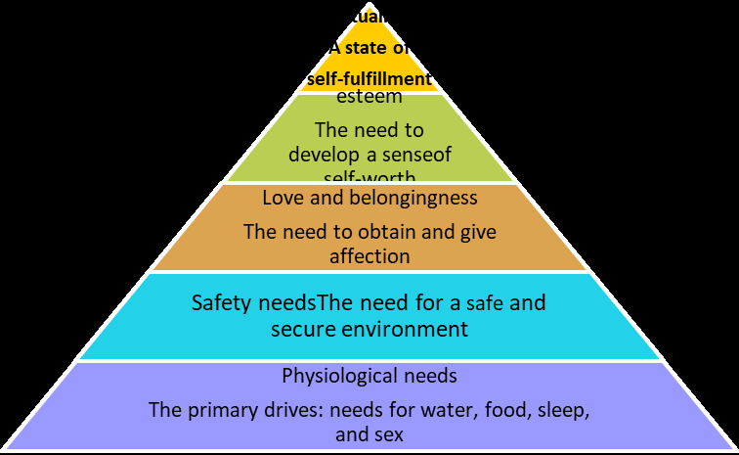

Slide 215
Cont…
There are two hierarchy of needs theory
Deficit principle
A satisfied need is not a motivator of behavior.
Progression principle
A need at one level does not become activated until the next lower-level need is satisfied.

Slide 216
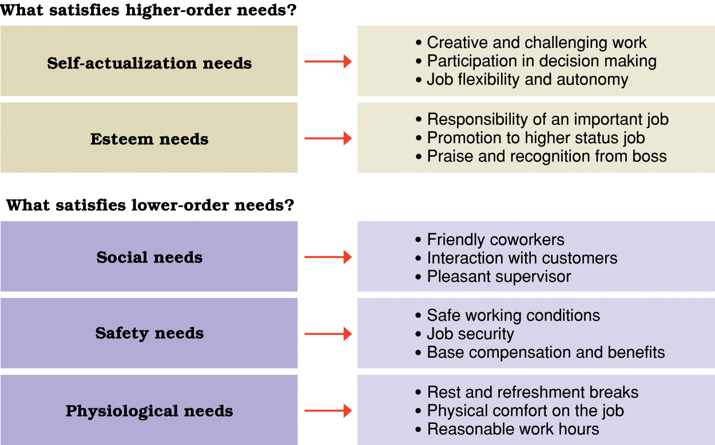
Conti… Opportunities for satisfaction in Maslow’s hierarchy of human needs.

Slide 217
Frustration and Conflict of Motives
Frustration refers to to the blocking of any goal directed behaviour.
If motives are frustrated, or blocked, emotional feelings and behaviour often result. People who cannot achieve their important goals feel depressed, fearful, anxious, guilty, or angry.
Sources of Frustration
Environmental forces: Environmental factors can frustrate the satisfaction of motives by making it difficult or impossible for a person to attain a goal. Example lack of money, teacher, parent, police, etc.

Slide 218
Cont.…
Personal inadequacies: Setting unattainable goals can be important sources of frustration. People are often frustrated because they aspire to goals beyond their capacity to perform.
Conflict of motives: Conflict exists whenever a person has incompatible or opposing goals.
The frustration comes from being unable to satisfy all the goals.
Whatever goal the person decides to satisfy, there will be frustration, most likely preceded by turmoil (confuse disturbance), doubt, and vacillation (unable to decide).
Example: Aggression and social approval are in
conflict (Why?)

Slide 219
Motivational Conflict
Of the three general sources of frustration described above the one that often produces the most persistent and deep-seated frustration in many individuals is motivational conflict/ conflict of motives.
There are about four basic kinds of motivational conflicts. 1. Approach- Approach Conflict
Occurs when one is simultaneously/ equally attracted to two or more desirable goals/ outcomes.
Generally, such conflicts cause little distress and are easily resolved.
The reason is that although we must choose one alternative now, we can often obtain the other at a later time or give up it.
E.g. attracted to two depts., attracted to huger and sleep

Slide 220
2. Avoidance- Avoidance Conflict
This conflict occurs when we are motivated to avoid each of two (or more) equally unattractive choices, but must choose one.
Avoidance- avoidance conflicts tend to involve a great deal of vacillation and hesitation.
Moving closer to one of the unattractive choices increases our discomfort and leads us to retreat.
This retreat brings us closer to the other unattractive alternative, and we retreat in the opposite direction.
Example: Studying hard or Failure, Working job we dislike or losing income.
Such conflicts are capsuled in the saying, “caught between the devil and the deep blue sea.”

Slide 221
3. Approach-avoidance conflict
This kind of conflict occurs when a person is motivated to both approach and avoid the same goal object.
In these kinds of conflicts both attraction and repulsion are typically strongest when you are nearest the goal.
The closer you are to something appealing, the stronger your desire to approach it; but the closer you are, the negative valence becomes stronger and you desire to flee.
In such cases people reach the goal but much more slowly and hesitantly than they would have without the negative valence.
Until the goal is reached there is frustration.

Slide 222
Cont.…
Even after the goal is reached, an individual may feel uneasy because of the negative valence attached to it.
Whenever a person is frustrated by not reaching it at all, emotional reactions such as fear, anger, and resentment commonly accompany approach avoidance conflicts. E.g. Getting married or losing her job or marriage in itself.
4. Multiple approach-avoidance conflicts
Such conflicts are the ones we most often face in life.
These involve situations in which several options exist, with each one containing both positive and negative elements.
Not surprisingly these are the hardest to resolve and the most stressful. E.g. Living in countryside or in city

Slide 223

Emotion
Notes:
We’ll talk about
- how emotions expressed and identified
- some theories of how emotions work
- how the nervous system is involved in the process of producing emotions
- and something about what is happening in the example of aggression and violence

Slide 224
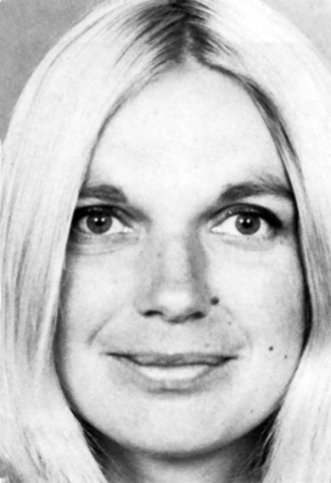
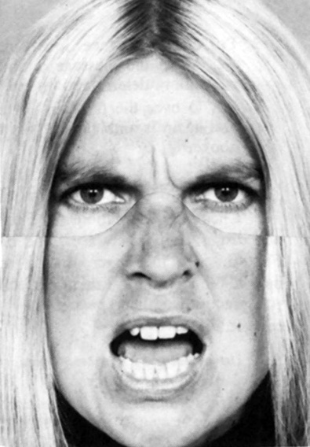
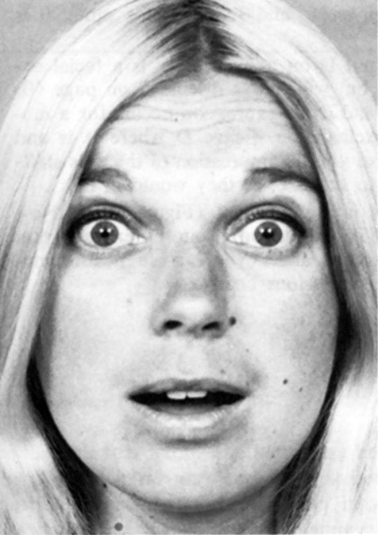
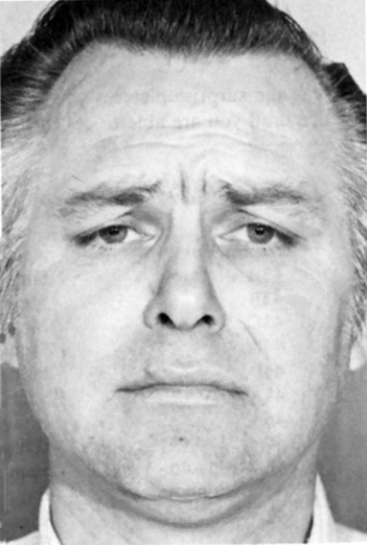
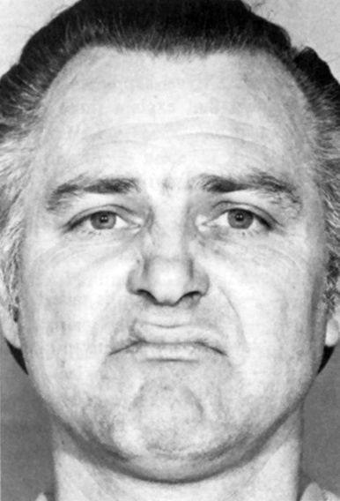
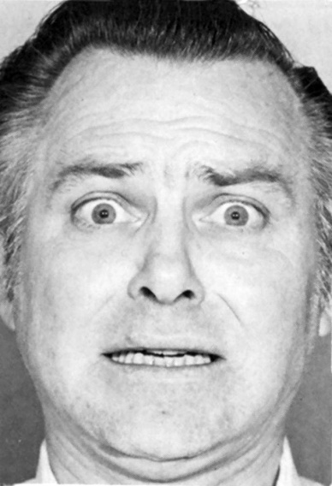
Can You Label These Emotions?
Notes:
Happiness, anger, surprise, disgust, sadness, fear

Slide 225
Emotion
Emotion:
A state of arousal involving facial and body changes, brain activation, cognitive appraisals, subjective feelings, and tendencies toward action, all shaped by cultural rules.
Subjective experiences that arise spontaneously and unconsciously in response to the environment around us.

Slide 226
Cont.
It can be defined as the “feeling” aspect of consciousness, characterized by certain physical arousal, certain behavior that reveals the feeling to the outside world, and an inner awareness of feelings.
Thus, from this short definition, we can understand that there are three elements of emotion: the physiology, behavior, and subjective experience.

Slide 227
Cont.
The physiology of emotion - when a person experiences an emotion, there is physical arousal created by the sympathetic nervous system.
The heart rate increases, breathing becomes more rapid, the pupils of the eye dilate, and the mouth may become dry.
The behavior of emotion- tells us how people behave in the grip of an emotion.
There are facial expressions, body movements, and actions that indicate to others how a person feels.
Frowns, smiles, and sad expressions combine with hand gestures, the turning of one’s body, and spoken words to produce an understanding of emotion.

Slide 228
Cont.
Subjective experience or labeling emotion-is the third component of emotion and it involves interpreting the subjective feeling by giving it a label: anger, fear, disgust, happiness, sadness, shame, interest, surprise and so on.
Another way of labeling this component is to call it the ―cognitive component, because the labeling process is a matter of retrieving memories of previous similar experiences, perceiving the context of the emotion, and coming up with a solution- a label.

Slide 229
Emotion (Conti…)
How can we know emotion in others?
Through non-verbal cues such as facial expressions, eye-contact, body movements and posture, and touching.

Slide 230
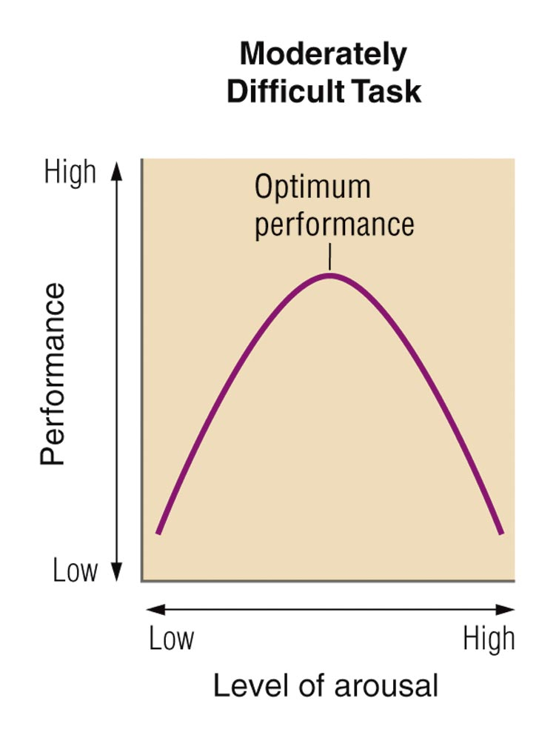
Purposes of Emotion
Arousal
Arousal – get us ready to make a needed response (motivate studying for a test) or Fight or Flight
Communication: make our needs/wants known to others, or our intentions (what might you do if you are really frustrated? Punch/hit a wall, yell at someone)
The Yerkes-Dodson La
Notes:
Arousal – get us ready to make a needed response (motivate studying for a test)
Optimum level of arousal – we don’t do well if not very aroused, but we also don’t do well if too aroused – there’s a happy medium
Communication – make our needs/wants known to others, or our intentions (what might you do if you are really frustrated? Punch a wall, yell at someone)

Slide 231
Theories of Emotion
Does your heart pound because you are afraid... or are you afraid because you feel your heart pounding?

Slide 232
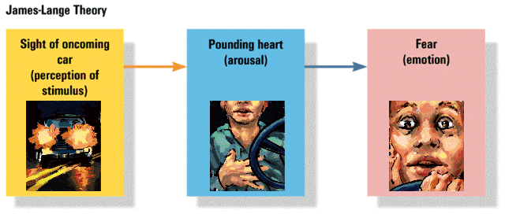
1. James-Lange Theory of Emotion
Experience of emotion is awareness of physiological responses to emotion-arousing stimuli
Emotion arises from physiological arousal
Sight of
oncoming
car
(perception of
stimulus)
Pounding
heart
(arousal)
Fear
(emotion)

Slide 233
2. Cannon-Bard Theory of Emotion
Pounding
heart
(arousal)
Emotion-arousing stimuli simultaneously trigger:
physiological responses
subjective experience of emotion
Sight of
oncoming
car
(perception of
stimulus)
Fear
(emotion)

Slide 234

3. Schachter and Singer Two-Factor and Cognitive Arousal Theory
To experience emotion one must:
be physically aroused
cognitively label the arousal
That is:
Event- arousal + reasoning-emotion
Pounding
heart
(arousal)
Sight of
oncoming
car
(perception of
stimulus)
Fear
(emotion)
Cognitive
label
“I’m afraid”

Slide 235
4. Lazarus Theory
Lazarus Theory states that a thought must come before any emotion or physiological arousal.
In other words, you must first think about your situation before you can experience an emotion.
EXAMPLE: You are walking down a dark alley late at night. You hear footsteps behind you and you think it may be a robber so you begin to tremble, your heart beats faster, and your breathing deepens and at the same time experience fear.
EVENT _____Thought _____physical arousal + emotion

Slide 236
5. Facial Feedback Theory
According to the facial feedback theory, emotion is the experience of changes in our facial muscles.
In other words, when we smile, we then experience pleasure, or happiness. When we frown, we then experience sadness.
It is the changes in our facial muscles that cue our brains and provide the basis of our emotions.
Just as there are an unlimited number of muscle configurations in our face, so too are there a seemingly unlimited number of emotions.

Slide 237
Cont..
EXAMPLE: You are walking down a dark alley late at night. You hear footsteps behind you and your eyes widen, your teeth clench and your brain interprets these facial changes as the expression of fear. Therefore you experience the emotion of fear.
Event_______ Facial Changes _______ Emotion

